Slide 1
NEO4J CYPHER TUTORIAL WITH PYTHON
Remove Labels From Neo4j Node Using Apoc Procedure & Python
Tutorial 99

Slide 2
Use case
Remove Labels From Neo4j Node Using Apoc Procedure & Python

Slide 3
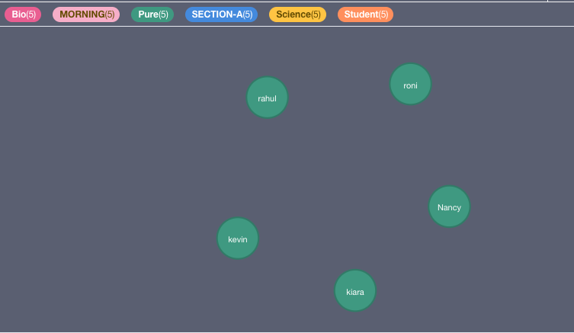
Remove all labels except Student label

Slide 4
Remove Labels From Neo4j Node Using Apoc Procedure & Python
call db.labels()
yield label where label <> "Student"
with collect(label) as label
match(a)
with collect(a) as nodes,label
call apoc.create.removeLabels(nodes,label)
yield node
return node,labels(node) as labels
Code written in neo4j browser

Slide 5
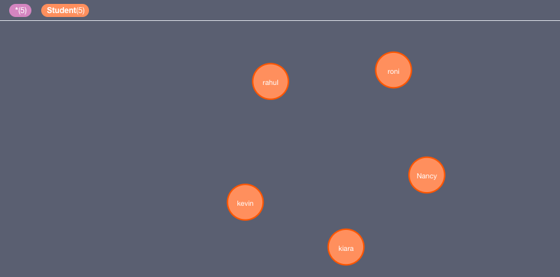
output
From python ide

Slide 6
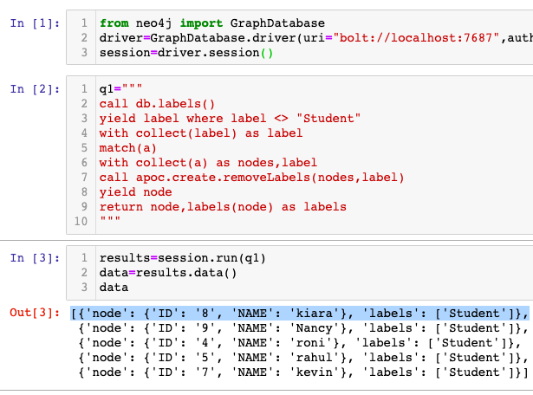
Remove Labels From Neo4j Node Using Apoc Procedure & Python
Code written in python ide

Slide 7
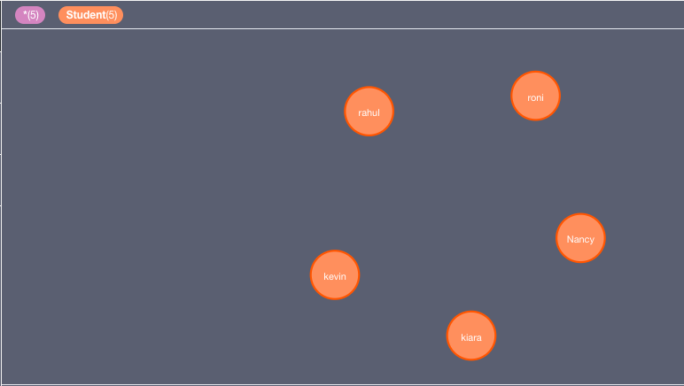
output
From python ide

